Slide 1

EE150 Signals and Systems
Tutorial 6
Guorui Cui
Shanghaitech University
April 2024
Tutorial 6
EE 150
April 2024

Slide 2
Outline
Outline
1. Fourier series
2. Property of FS in CT
3. Property of FS in DT
4. Analysis of HW2.
Tutorial 6
EE 150
April 2024

Slide 3
01
FS
1. Fourier series
Tutorial 6
EE 150
April 2024

Slide 4
01
Fourier series
Orthogonal function set
Consider the set, S, of x(t) satisfying x(t) = x(t+T)
Dot-product (inner product) is defined as
The definition of orthogonal functions:
Consider the exponential function set:
The exponential function set
are orthonormal.
Tutorial 6
EE 150
April 2024

Slide 5




01
Fourier series
Orthogonal function set
Consider the set, S, of x[n] satisfying x[n] = x[n+N]
Dot-product (inner product) is defined as
$<x_{k}[n],x_{m}[n]>=\frac{1}{N}Σ_{n=1}^{N−1}$ $x_{k}\left[n\right]x_{m}^{∗}[n$]
The definition of orthogonal functions:
$$<x_{n}[k],x_{m}[k]>=0,n≠m \\ <x_{n}[k],x_{m}[k]>=c,n=m$$
$$φ_{k}[n]=e^{jkw_{0}n};w_{0}=\frac{2π}{N},k∈ℤ$$
Consider the exponential function set:
$$<φ_{n}[k],φ_{m}[k]>=0,n≠m \\ <φ_{n}[k],φ_{m}[k]>=1,n=m$$
The exponential function set
are orthonormal.
Tutorial 6
EE 150
April 2024

Slide 6
01
Fourier series
Orthogonal function set
Ex1.
Verify the orthogonality of the set of trigonometric functions on
Tutorial 6
EE 150
April 2024

Slide 7
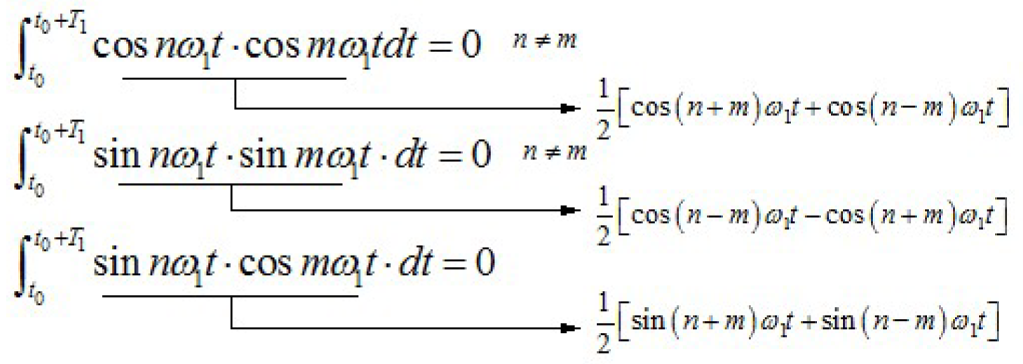
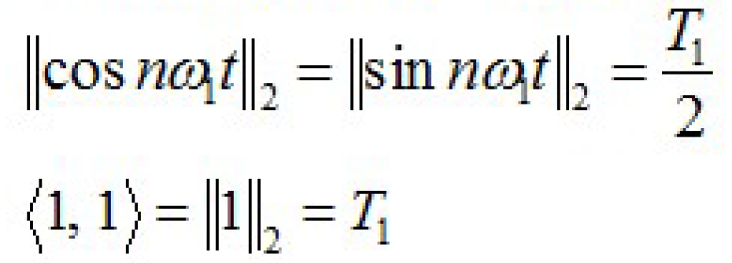
01
Fourier series
Orthogonal function set
Ex1.
Verify the orthogonality of the set of trigonometric functions on
Solution.
Tutorial 6
EE 150
April 2024

Slide 8
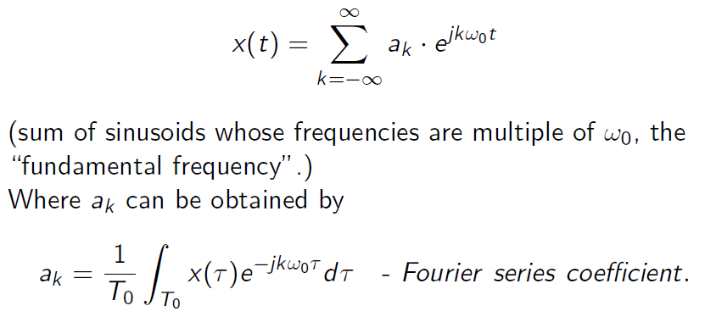
01
Fourier series
Complete orthogonal function set
Similar to a complete orthogonal basis in a vector space.
is a complete orthogonal function set.
If x(t) satisfies some condition, then it can be expressed as
Tutorial 6
EE 150
April 2024

Slide 9
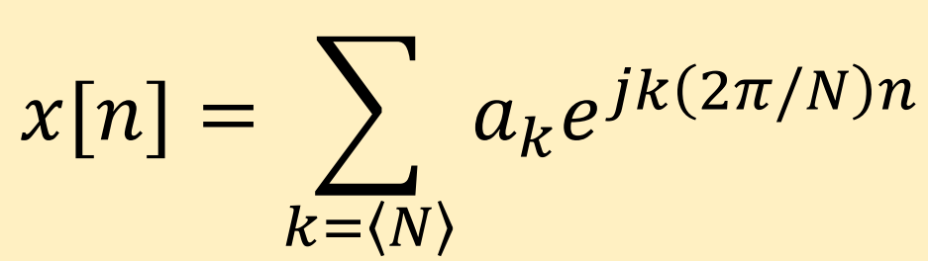
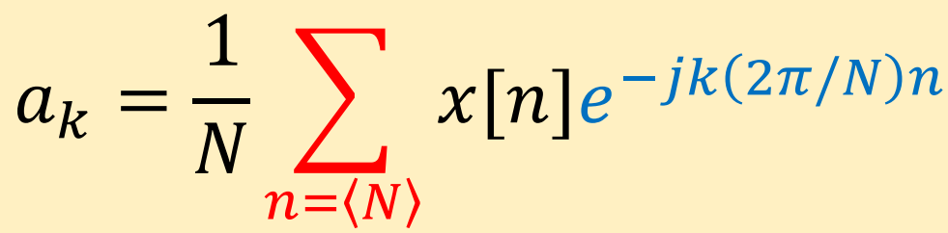
01
Fourier series
For DT situation
Similar to last page, we can get
And the Fourier Series Coefficient
Tutorial 6
EE 150
April 2024

Slide 10


01
Fourier series
Complete orthogonal function set
Ex2.
Let
be a periodic signal with fundamental period T=2 and Fourier coefficients
1. Determine the value of $a_{0}$
2. Determine the Fourier coefficients $b_{k}$ of
Tutorial 6
EE 150
April 2024

Slide 11

01
Fourier series
Ex2.
Let
be a periodic signal with fundamental period T=2 and Fourier coefficients
1. Determine the value of
2. Determine the Fourier coefficients $b_{k}$ of
Solution.
1.
2.
T=2
Tutorial 6
EE 150
April 2024

Slide 12
01
Fourier series
Complete orthogonal function set
is also a complete orthogonal function set.
Using Euler’s relation:
Tutorial 6
EE 150
April 2024

Slide 13
01
Fourier series
Complete orthogonal function set
Ex3.
A continuous-time periodic signal x(t) is real valued and has a fundamental
period T = 8. The nonzero Fourier series coefficients for x(t) are
Express x(t) in the form
Tutorial 6
EE 150
April 2024

Slide 14
01
Fourier series
Ex3.
A continuous-time periodic signal x(t) is real valued and has a fundamental
period T = 8. The nonzero Fourier series coefficients for x(t) are
Express x(t) in the form
Solution.
Tutorial 6
EE 150
April 2024

Slide 15
01
Properoties of FS
2.Properties of FS in CT.
Tutorial 6
EE 150
April 2024

Slide 16
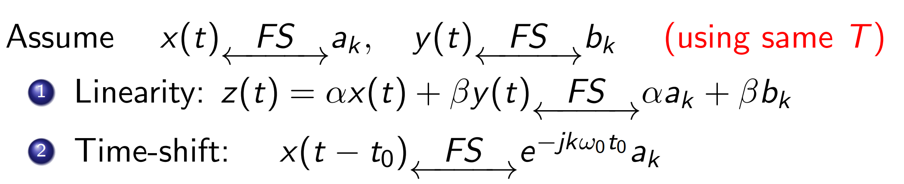
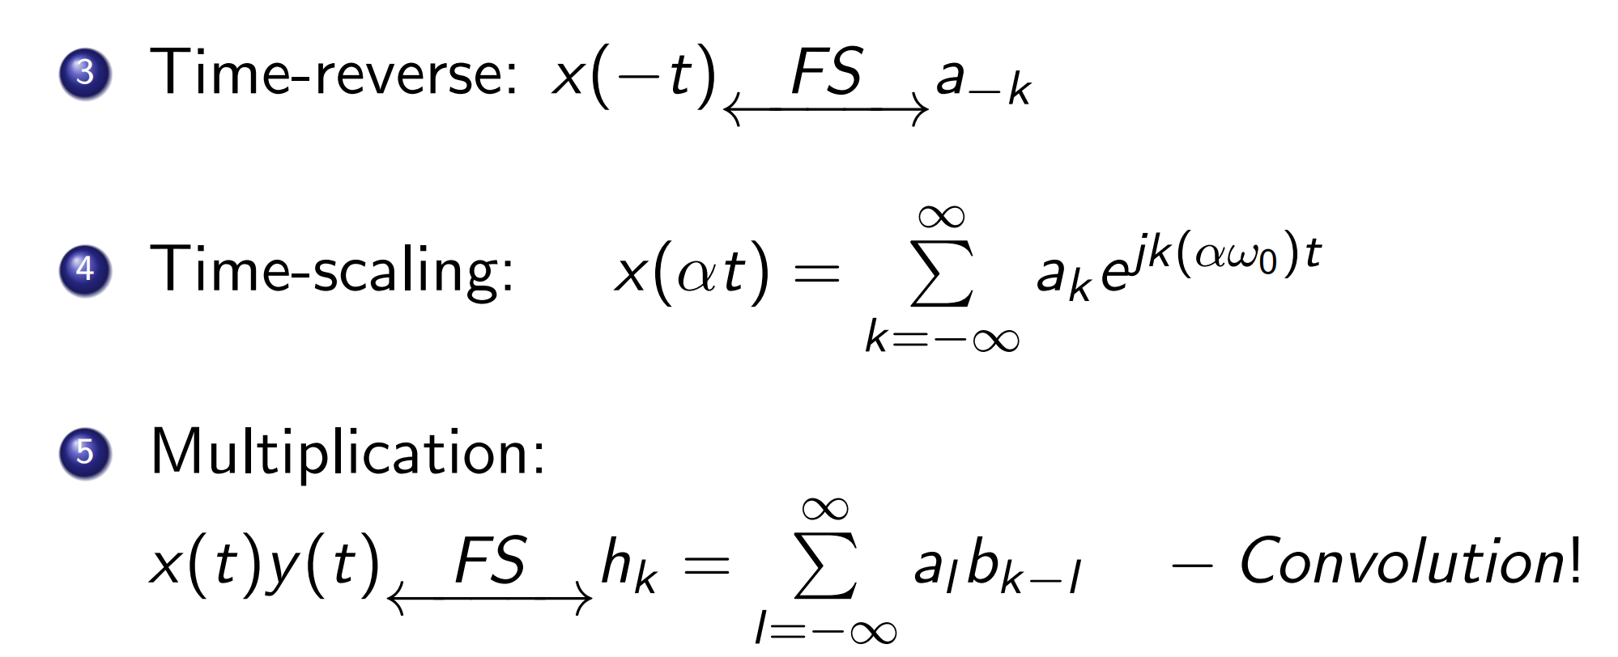
01
Properoties of FS
Tutorial 6
EE 150
April 2024

Slide 17
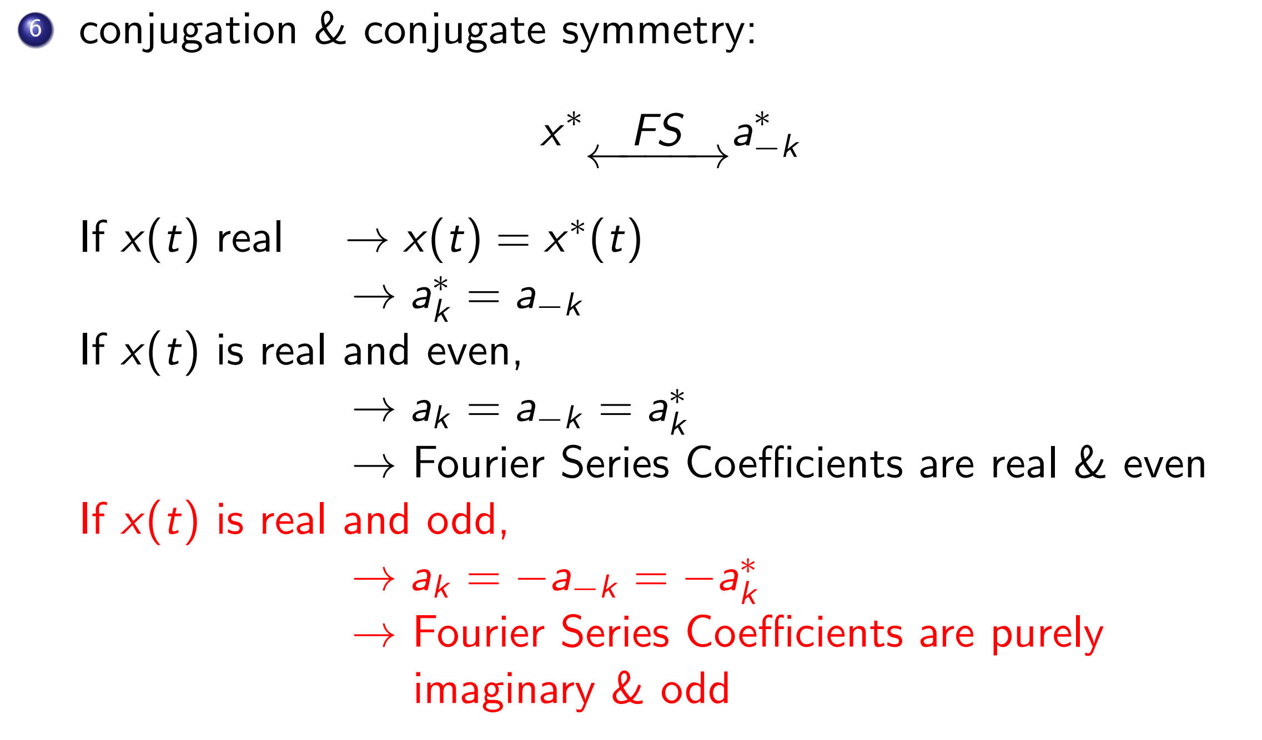
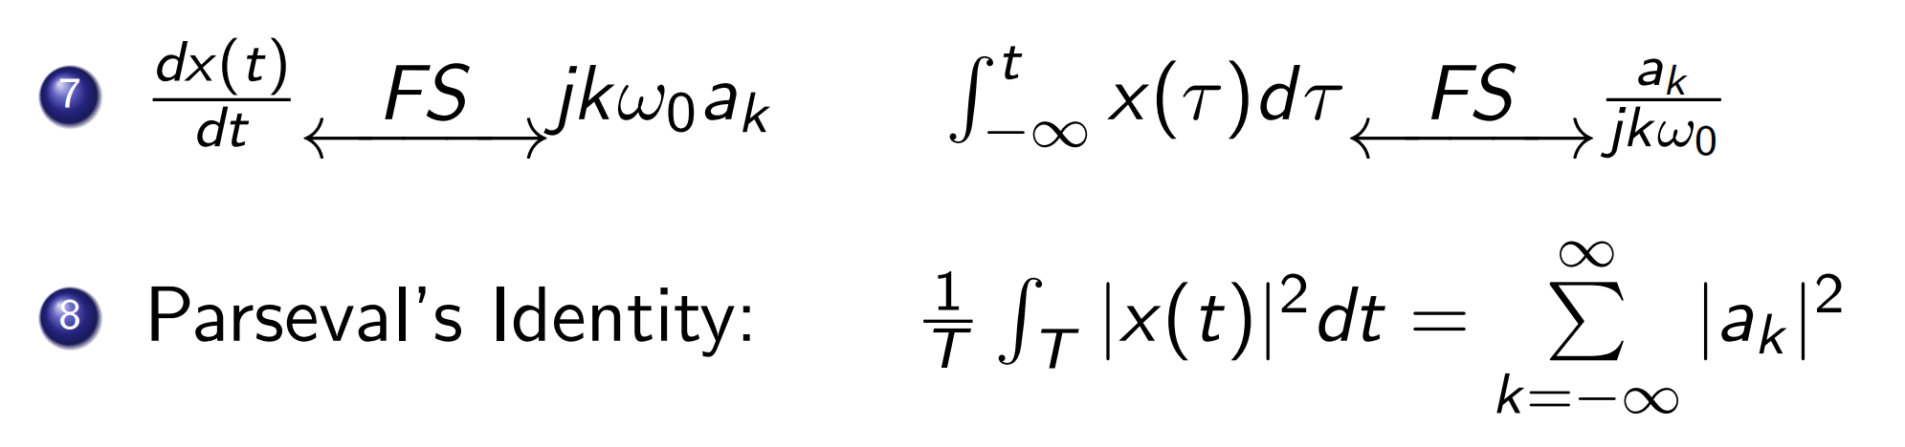
01
Properoties of FS
Tutorial 6
EE 150
April 2024

Slide 18
01
Properoties of FS
3.Properties of FS in DT.
Tutorial 6
EE 150
April 2024

Slide 19
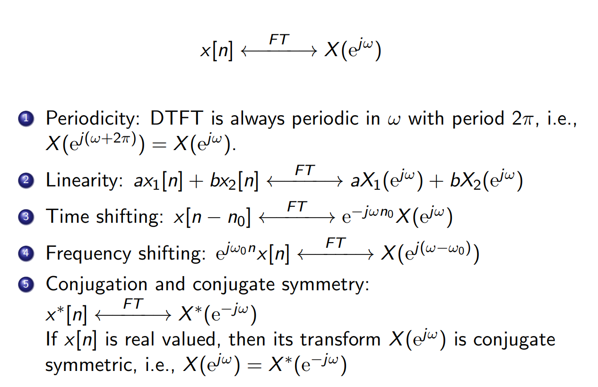
01
Properoties of FS
Tutorial 6
EE 150
April 2024

Slide 20
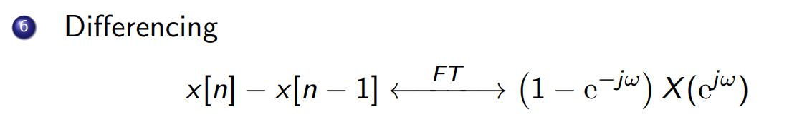
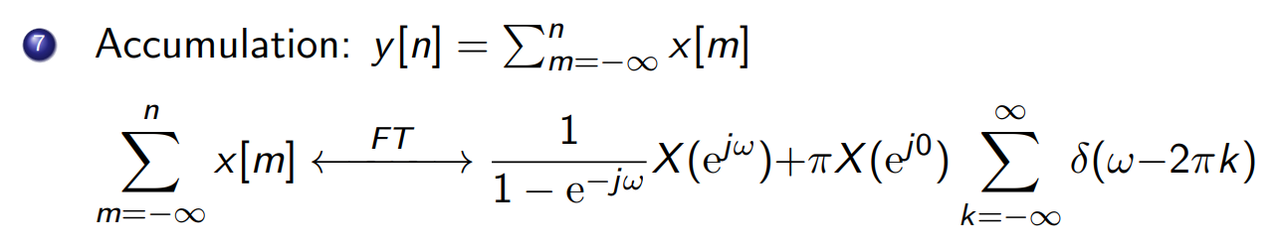
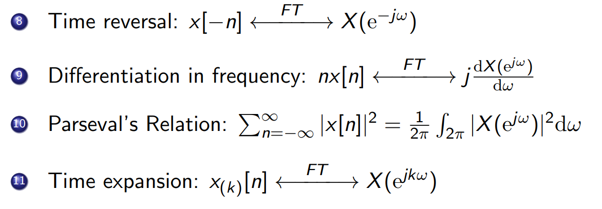
01
Properoties of FS
Tutorial 6
EE 150
April 2024

Slide 21
01
Properoties of FS
##Recommended to write them on the cheat sheet.
Tutorial 6
EE 150
April 2024

Slide 22
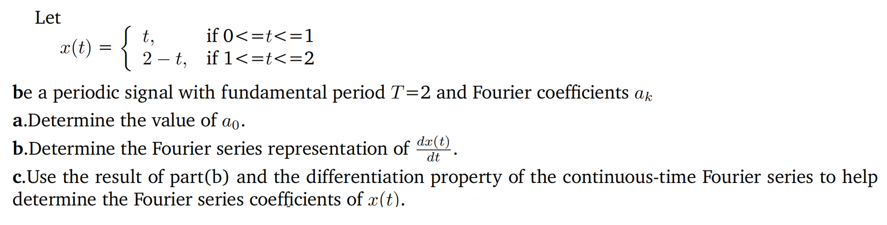
01
Properoties of FS
Ex.2
Tutorial 6
EE 150
April 2024

Slide 23
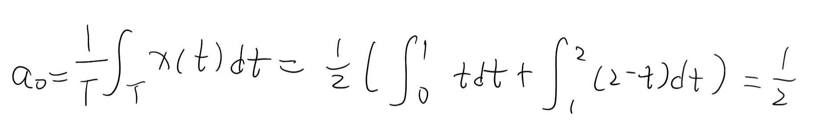
01
Properoties of FS
Ex.2
Tutorial 6
EE 150
April 2024

Slide 24
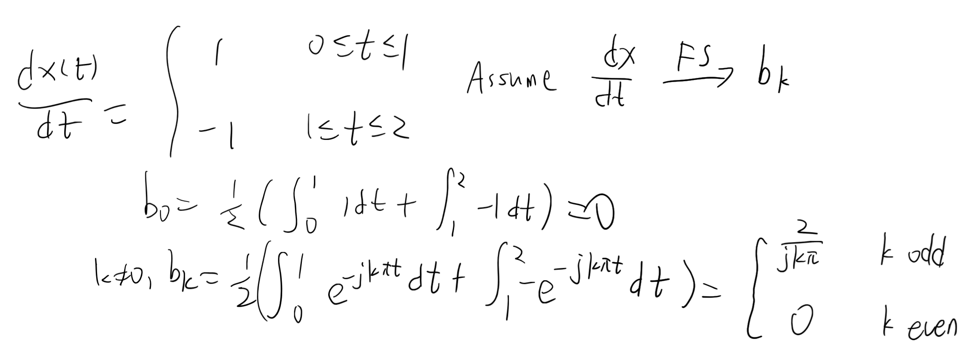
01
Properoties of FS
Ex.2
Tutorial 6
EE 150
April 2024

Slide 25
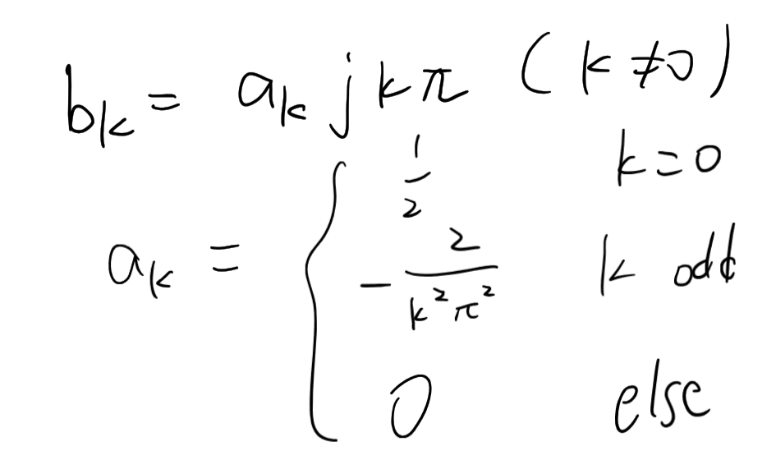
01
Properoties of FS
Ex.2
Tutorial 6
EE 150
April 2024

Slide 26
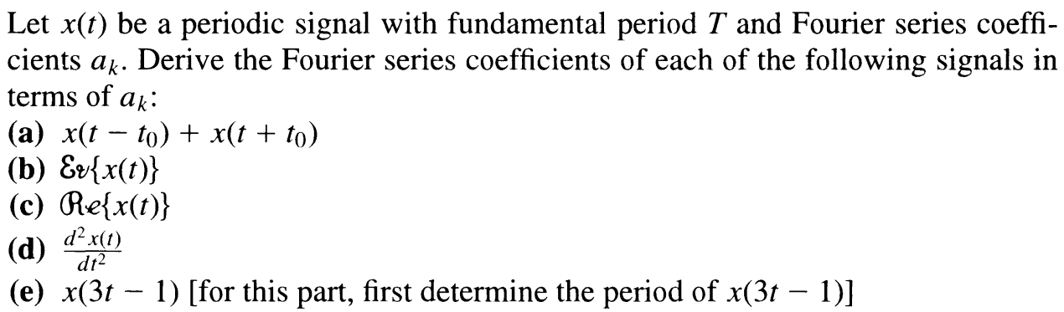
01
Properoties of FS
Ex.3
Tutorial 6
EE 150
April 2024

Slide 27
01
Properoties of FS
Ex.3
Tutorial 6
EE 150
April 2024

